Slide 1
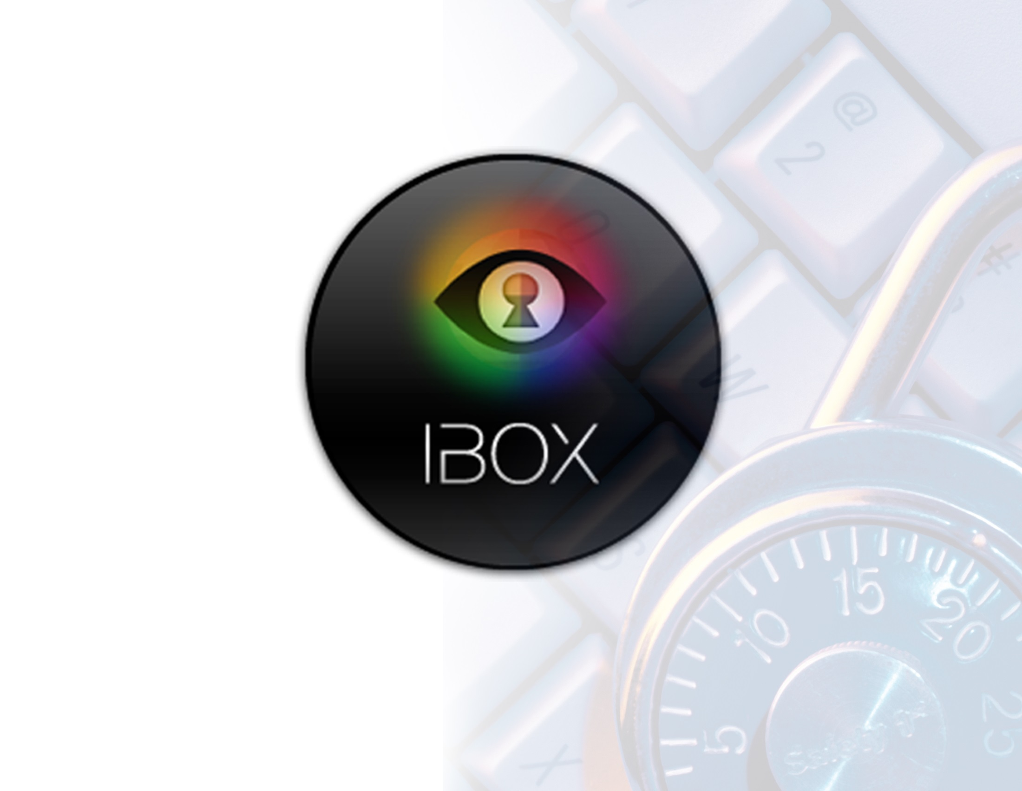

Slide 2

Executive Summary
iBOX CyberSecurity, LLC develops a platform for user controlled privacy and security.
The iBOX platform is a set of tools controlled by the user that aims to preserve his/her digital
identity while helping corporations to do business in a cheaper and more ethical way.
Mission:
Empowerment & Preservation of Digital personalities. iBOX platform presently under development and available are
our virtual iBOX computer and Vanishing Data as software products. iBOX hardware solutions are:
iBOX computer iBOX computer on a stick iBOX Vision
Long Term Goal: Further development of tools that help the user to protect their privacy
and security of their Digital Personality in parallel with the Physical world.

Slide 3
Executive Summary
Elena Paolercio
In 2009 joined Bridge Metal Industry (BMI), a manufacturing firm in Mount Vernon, New York.
After BMI fell victim to a massive cyber fraud, began collaborating with computer science
students and faculty at Fordham University and came up with the idea of a secure virtual
computer. In 2011 together with a team of developers and security consultants, Elena released
the first version of iBOX. While developing her idea, Elena was also working on her Master’s
Degree in Computer Science from Fordham University, which she received in spring 2013.
In addition was a member of organizing committee of International Conference on Cyber
Security 2010. http://www.iccs.fordham.edu/
Member of OWASP foundation since 2009.
Elena received her first Master Degree in Economics from Moscow Cooperative University,
Moscow Russia.
Robert Blanchard
has over 35 years of experience with businesses across a broad range of industries.
Mr. Blanchard graduated from Case Western Reserve University with a degree in mathematics
and has a Masters from the University of Oregon in advanced mathematics.

Slide 4
Corporate Timeline
Meeting with Cyber Security Group at Fordham, obtaining an idea of secure stand alone “banking computer”.
User-friendly computer on a stick was created. iBOX - portable Virtual Machine with Linux OS. Looks like a browser acts like a computer.
Developing stand alone “banking computer”
with customized Linux based OS.
Beta version
of iBOX released.
Vanishing Data development
July 2009
October 2009
2010
July 2010
December 2010
February 2011
July 2011
January 2012
May 2013
July-Aug
2013
Over $1,000,000.00
was stolen from the manufacturing company
where Elena was employed by Robert Blanchard, Bridge Metal LLC’s corporate Citibank account.
While accounts were canceled few minutes before, the money was transferred to Eastern European countries. The case was highlighted in the media, and brought a lot of public attention.
Established
as an LLC.
“Banking Computer on the USB” - bootable USB with customized Linux OS was created. This version of “banking computer” requires user to restart the computer.
First version of
iBOX released.
iBOX + Vanishing Data = preservation of virtual identity - conceptualized
Owned at present by Robert Blanchard.
Elena Paolercio has an option on 25% of Partnership.

Slide 5
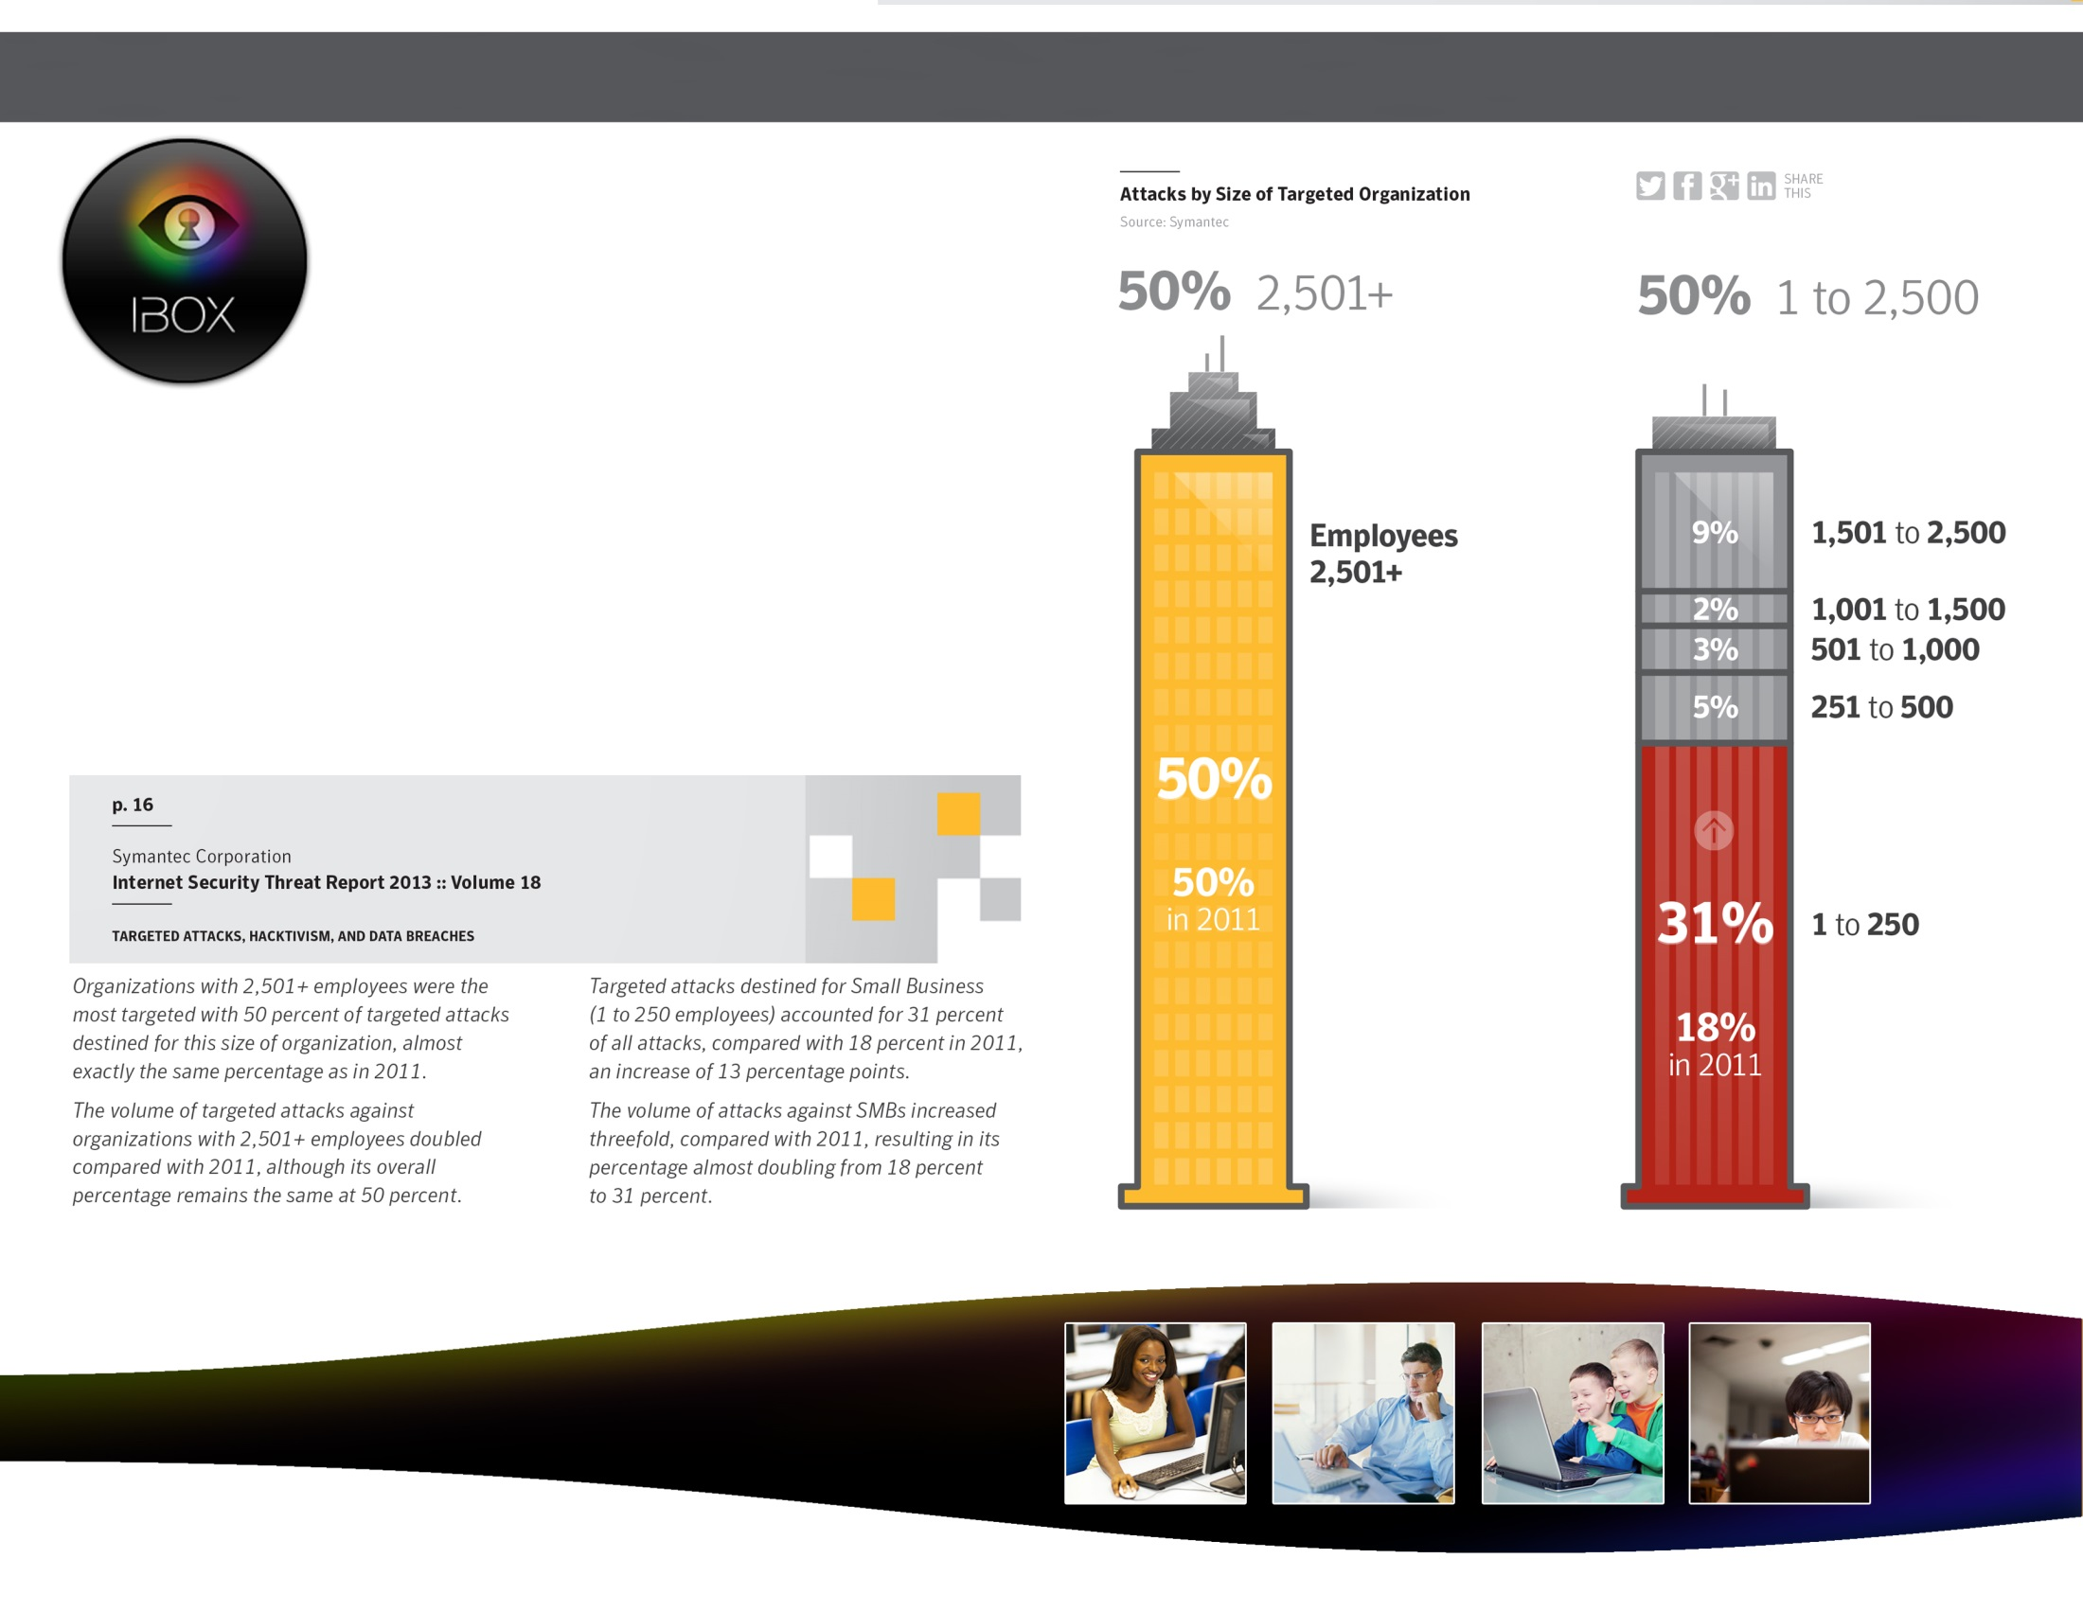
Robust Demand for Privacy and Security solutions
Source: http://blog.veriphyr.com/2011/12/cost-medical-identity-theft.html
Symantec statistics Small Businesses http://www.symantec.com/content/en/us/enterprise/other_resources/b-istr_main_report_v18_2012_21291018.en-us.pdf

Slide 6
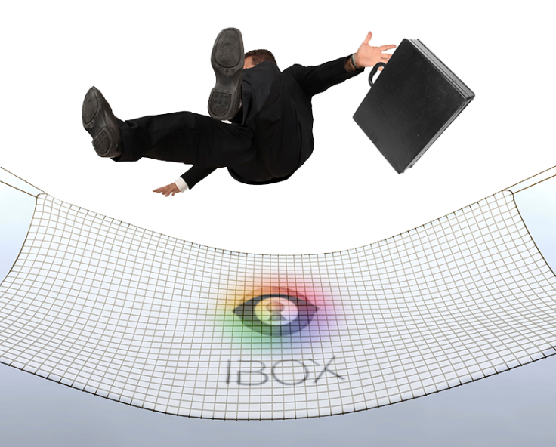

Robust Demand for Privacy and Security : YOUR DATA
solutions
Problem: Black market prices
for your personal data
Medical records $50
Social Security numbers $3
Credit Card information $1.50
Date Of Birth $3
Mother's maiden name $6
Bank accounts $10 to $1,000
“Full identities” (date of birth, address,
social security and telephone numbers)
selling for between $1 and $15
Solution:
Our solution attacks the problem at its
roots. Since something needs to exist in
order for it to be stolen, we have decided
to solve thievery by taking away the
essential ingredient of what is being
targeted by these thieves: your data.
Cyber crime has matured in to a
sophisticated industry where each theft
has to make economical sense.

Slide 7
Software Development Expertise
iBOX Team:
Nicolas Hammond has over 20 years of experience in the Internet security and software development. Nicolas set up security of the first Internet bank and conducted the first-ever online transaction. Mr. Hammond currently holds two patents in computer security. Nicolas graduated from Cambridge University, UK with bachelor degree in Mathematics and Masters Degree in computer Science. Nicolas wrote a book “How to solve a Rubik’s Cube in 37 seconds”, published 1981.
Evgenia Shostak is one of the key members of iBOX team. She has a background in development of large software systems implementing complex mathematical calculations. Evgenia graduated from Belarus State University of informatics, BSUIR, Belarus, Minsk with a Bachelor Degree in Computer Science.
Ayush Shrestha is an experienced software engineer. Ayush has been a valuable iBOX team member as a Software developer. He specialized on open source software customization. He is currently in his final year of PhD program in Computer Science from Georgia State University.
Ankur Dongle during his 9-month internship with the iBOX team has greatly influenced the product, as presently constituted. Ankur graduated with a Masters Degree in Computer Science form University of Florida. Currently Ankur works for Microsoft as a Software Developer.

Slide 8

Key Investment Considerations
Products already developed
iBOX computer on a stick helps to create a highly secure and private environment on any Mac or Windows computer. It is small, fast, and easy to use. Plug and Play! iBOX is a platform with many customizable levels of security and privacy. It could be a banking center, a wallet, or even a mailbox and all of it at your fingertips anywhere you go. SWOT analysis iBOX computer on a stick
iBOX computer on a stick video
Strength
Weaknesses
Portable
Light (easily downloadable)
Fast
Highly customizable for any environment
Provides more private and secure environment
Utilizing strength above could integrated in other software solutions
Difficult to market
Keeping up with constantly evolving cyber threats
Opportunities
Threats
Lower the cost for developers
Increase the value of the end product
Creates platform with more secure and private environment
The concept of iBOX could be replicated by a bigger company

Slide 9
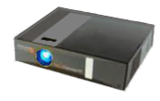
Investment Considerations
Products already developed
iBOX Vision is a small, light weight, portable device. As big as a bar of soap, iBox Vision includes a CPU, an LED projector, and a wireless card. It is preloaded with iBOX software making the device more secure and private. iBOX Vision could convert virtually any place with wireless Internet or hot spot from your phone in to library, office or Movie Theater. Just simply turn the device on and navigate through the Internet using iBOX virtual keyboard. Enjoy having your data at the tip of your fingers.
SWOT analysis iBOX Vision
Strength
Weaknesses
Novel concept
Portability
LED production facility available
Technical staff available
iBOX part is highly customizable
Could be integrated with other software solutions
Difficult to market
Production cost
Opportunities
Threats
To be represented on the market of mobile devices
Lower the cost for developers
Increase the value of the end product
The concept of iBOX Vision could be replicated by a bigger company
Inability to bring the product to desirable markets

Slide 10


Investment Considerations
Products to be developed
iBOX for mobile platforms
iBOX for Smart Phones creates a secure, isolated environment for safe
communication with financial institutions. It runs on a separate operating
system, to provide the highest level of security. iBOX deployed on
Smart Phones provide users with security on the go.
Vanishing Data software
Vanishing Data focuses on an integration of cryptographic techniques
that targets all types of data (emails, documents, and pictures),
and renders them unreadable after a specific period of time, determined
by the sender.
This data is irrecoverable even through intense forensic examinations.
Whether it is 30 seconds, 30 days, or years, the user controls how long
their data stays visible, after which time the information becomes
unavailable to the outside world, as well as yourself.
Vanishing Data video

Slide 11
Investment Considerations
Rough Timeline for Products to be developed
iBOX for Mobile Platforms
Gather resources
4-6 weeks
Define architecture of iBOX mobile app for Android and iOS
5 weeks
Development for Android Platform
8-10 weeks
Development for iOS Platform
12-16 weeks
Test
8-10 weeks
Documentation
4 weeks
Vanishing Data Project
Gather resources
5-8 weeks
Design and Develop web based working prototype
20 weeks
Test
4 weeks
Design and Develop FireFox plugin
8-10 weeks
Usability and Security Testing
12 weeks
Documentation
4 weeks

Slide 12
Software Design and Application
OUR Vision is different.
WHY are we different than all other privacy-security companies?
Our approach…

Slide 13
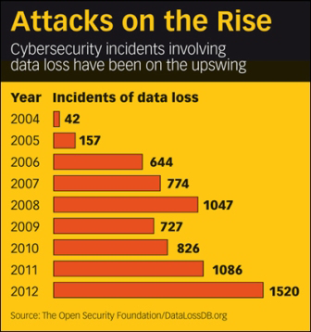
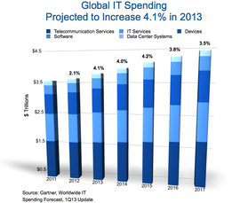
Financial Platform

Slide 14
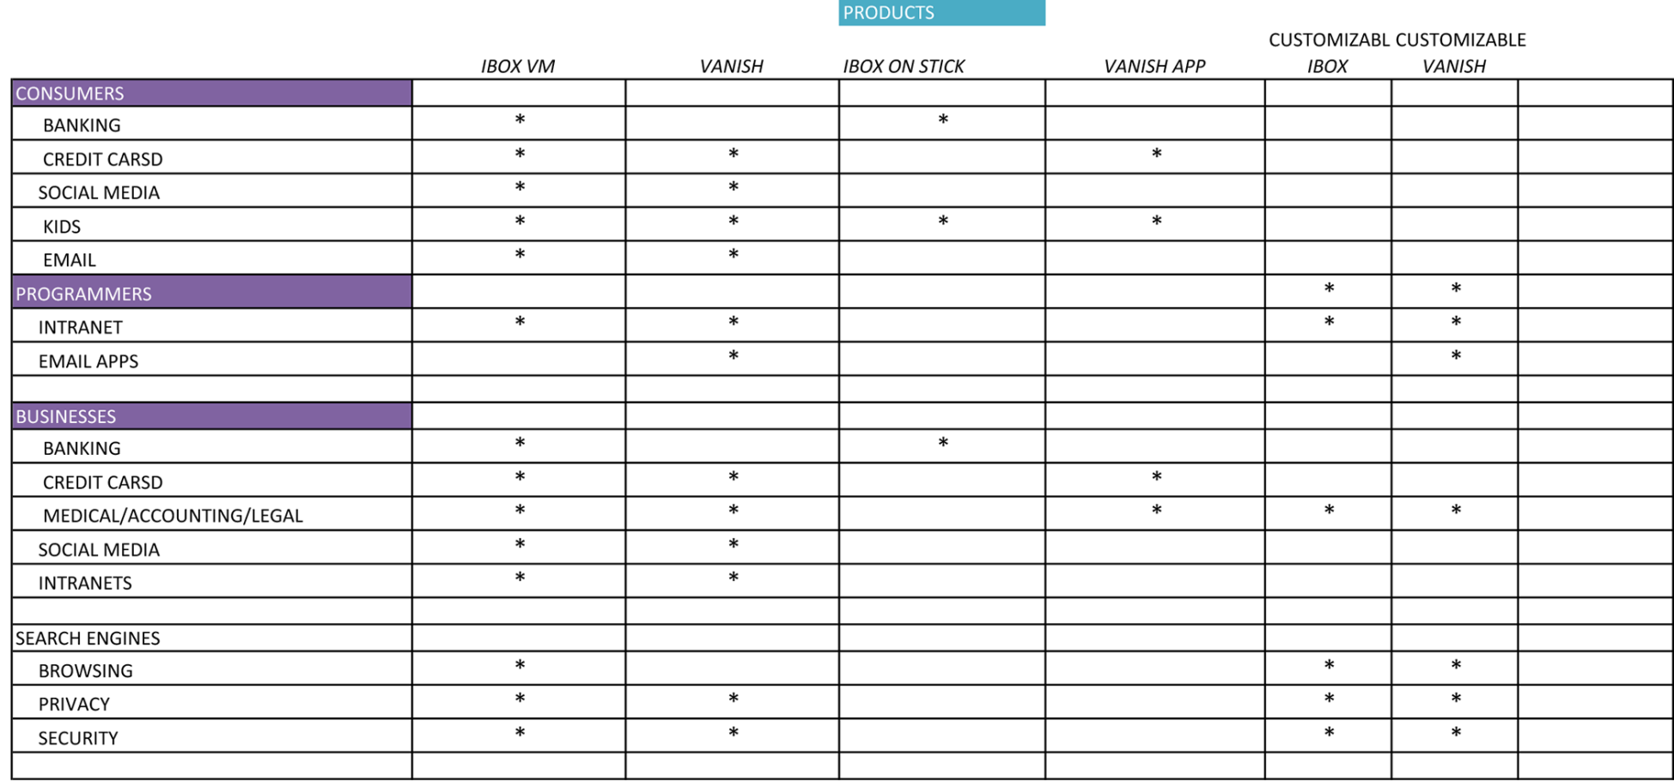
Financial Platform

Slide 15
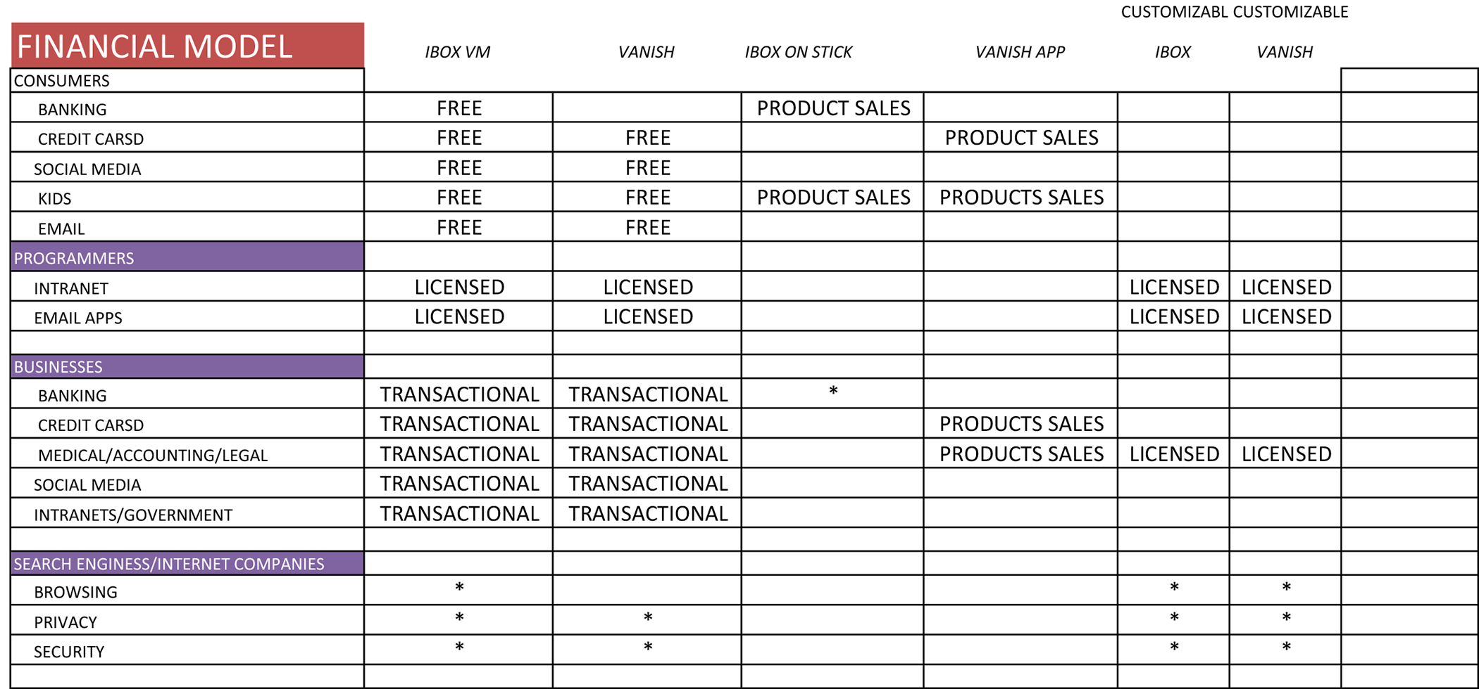
Financial Platform

Slide 16

CASE STUDIES
Case Study #1
Problem
After a major cyber theft at Bridge Metal Inc., in July 2009, Over $1,000,000.00 was stolen from Bridge Metal Industries LLC’s Citibank account. While accounts were canceled few minutes before, the money was transferred to Eastern European countries. The case was highlighted in the media, and brought a lot of public attention.
Solution
The solution to this problem is to conduct all the online transaction through ultimately secure, dedicated stand alone computer. Nothing else should be open or executed on that machine.
Practical solution – iBOX Banking computer on a stick. It implements security features of the virtual machine with Linux OS running. iBOX configured such way, so user can choose the level of security from very high with bank only destination to low with a variety areas of application

Slide 17
CASE STUDIES
Case Study #2
Problem
Developers of ACBL score+ are looking to upgrade software solution for bridge players. The new software must run on PC (WinXp, Win7, Win8) and Mac 10.5 and up. Hardware compatibility should also be taken in to consideration. These increase development and testing cost.
Solution
We compiled ACBL score+ software once in iBOX environment and shipped computer on the stick with the software in it to the end user. The user gets light, fast and portable version of the software. The developers decreased the cost of the release process and significantly shortened the time required for testing.

Slide 18
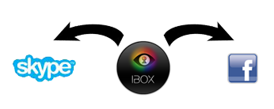

CASE STUDIES
Case Study #3
Problem
The balance between privacy, security and functionality is always a challenge. Most of the time application that provide security or/and privacy interfere with some other applications. For example, VPN client application SpotFlux stops the work of VoIP application Skype.
Solution
User can be given a choice of having Spotflux insides the iBOX, this way all the searches and browsing conducted from iBOX +SpotFlux are anonymous and private. In addition iBOX+SpotFluX could be brought to any computer, as iBOX is portable. iBOX application does not interfere with most applications utilized by the general public. The user can run all three applications at the same time.

Slide 19



Industry Overview
Cyber Criminals
15 million Americans had their data stolen in 2011, adding up to a staggering 50 billion dollars in losses. In the same year, 1.49 million Americans were affected by medical identity theft, with damages totaling 30.9 billion dollars.
Corporation
The Internet advertising revenues total 36.6 billion dollars in 2012, and that figure is projected to rise another 4 billion in the coming fiscal year.
Government
Lack of legal conditions on how personal data could be used inevitably lead to secondary uses that violate the user’s privacy.

Slide 20
Competitive Landscape
Software
Functionality
Why iBOX+Vanishing Data different?
SpotFlux
VPN, that aims to tunnel all the Internet traffic through their cloud, block unwanted ads, mask IP address, protect from malware and viruses, open access to restricted websites.
VPN, that aims to tunnel all the Internet traffic through their cloud, block unwanted ads, mask IP address, protect from malware and viruses, open access to restricted websites.
DoNotTruckMe
DeletMe
MaskMe
DoNotTrackMe is a browser add-on that blocks adds, eliminates third party tracking cookies.
DeletMe is a service that helps to delete personal information from leading data sites (list provided on the website).
MaskMe is a service that creates email and phone number to preserve customer’s phone number.
iBOX platform aims to help user’s to regain control over their data, not to mask it. Vanishing Data allows rendering data unreadable after specified time in all locations. iBOX platform does not keep user’s data – no way to compromise it.
HotSpotShield
VPN, encrypts the traffic, secure IP address for anonymity on line, aims to protect from eavesdropping on public Wi-Fi networks.
iBOX platform provides a very malleable set of features for user to manipulate their privacy and security settings.

Slide 21
Competitive Landscape
Software
Functionality
Why iBOX+Vanishing Data different?
Cotton Candy
It is a USB stick sized microcomputer, with CPU, RAM, Wi-Fi card and storage space available. Claims to provide secure single point access to user’s private cloud.
iBOX platform is a software that can reside on the USB device or on the hard drive of the computer or as an app for mobile device.
Quebes OS Project
Is an Linux Based OS , that implements security by isolation approach. Quebes utilizes virtualization technology, to be able to isolate various programs from each other, so that their compromise don’t affect the integrity of the rest of the system.
iBOX platform is seamless, it does not require user to install new OS and learn new set of skills. It also addresses privacy issues such as obtaining control over user’s data remotely.
DuckDuckGo
Search engine, that does not keep any records of visited pages as well as does not profile users. Used to search for private (embarrassing) content.
iBOX platform has a very similar model. We don’t want user’s data.

Slide 22
Competitive Landscape
Software
Functionality
Why iBOX+Vanishing Data different?
Silent Circle
Provides encryption services for email, phone calls, VoIP, text for subscribers within the circle and for communication outside of it. Consists of 4 different applications: Silent Mail, Silent Eye, Silent Phone, Silent text.
iBOX is a platform can be understood as a communication device, that provides secure and private environment on user’s computer. It exists both for Mac and Windows. iBOX platform utilizes different encryption technique where pieces of the key are geographically distributed and after predetermined period of time could not be decomposed.
Online backup share, sync, access and storage service. SpiderOak uses encrypted cloud storage and client-side encryption key creation, so even employees of SpiderOak cannot access users' information
iBOX platform does not store any user’s data. Utilizing Vanishing Data user’s don’t have to trust their data to a single location or encryption technique.
SpiderOak

Slide 23
What makes iBOX platform different?
Over all iBOX platform represents a unique well integrated set of tools that are aim
to embrace the user’s right to own, manipulate and destroy personal data.
User comes first
We believe that our user has a right and need to be in charge of his privacy. iBOX platform is built in a way that user remains to be in a full control over security and privacy settings. From highly secure to layback.
We don’t want user’s data
iBOX platform in its core concept does not collect to store, back up, tunnel or even encrypt any of user’s data. This single fact rolls out a lot of privacy risks.
Decentralization
Decentralization is one of the most unique and important features of its setup. The encryption that utilized by vanishing Data is decomposed on multiple pieces and spread all over the DHT network in geographically diverse locations. The key recovery can never be a mater of political influence.

Slide 24
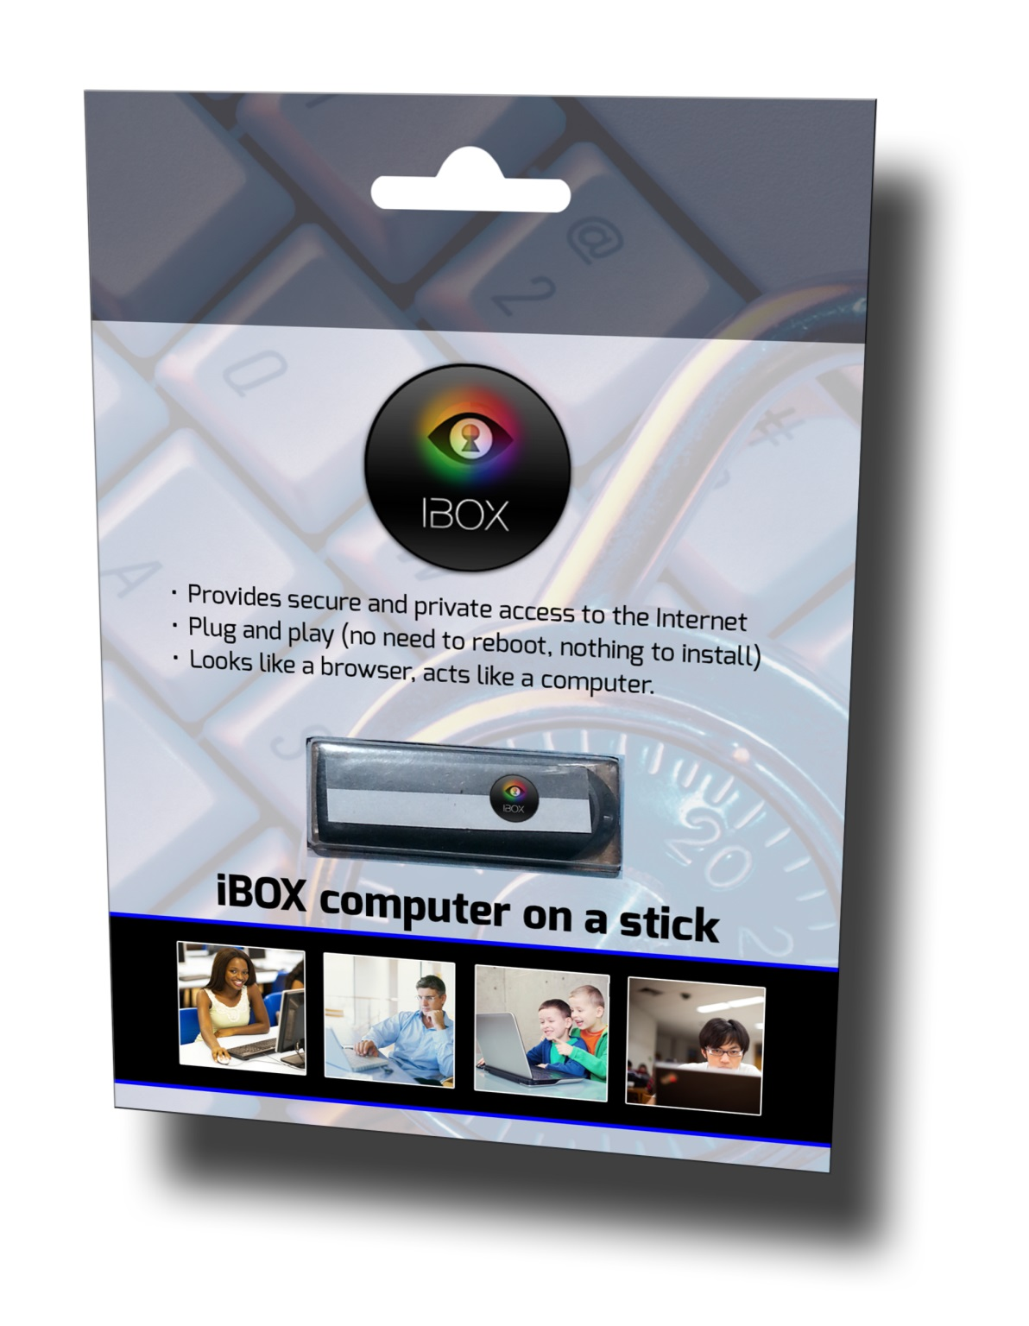
www.iboxcomputer.com

